Slide 1
Error Detection and Correction
Types of Errors
Detection
Correction

Slide 2
Basic concepts
Networks must be able to transfer data from one device to another with complete accuracy.
Data can be corrupted during transmission.
For reliable communication, errors must be detected and corrected.
Error detection and correction are implemented either at the data link layer or the transport layer of the OSI model.

Slide 3
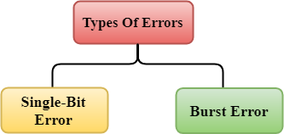
Types of Errors

Slide 4
Single-bit error

Slide 5
Single-bit error means that only 1 bit of a given data unit is changed from 1 to 0 or from 0 to 1. Single bit errors are the least likely type of errors in serial data transmission because the noise must have a very short duration which is very rare. However, this kind of errors can happen in parallel transmission.

Slide 6
The term burst error means that two or more bits in the data unit have changed from 1 to 0 or from 0 to 1.
Burst errors does not necessarily mean that the errors occur in consecutive bits, the length of the burst is measured from the first corrupted bit to the last corrupted bit. Some bits in between may not have been corrupted.
The number of bits affected depends on the data rate and duration of noise.

Slide 7
Burst error

Slide 8
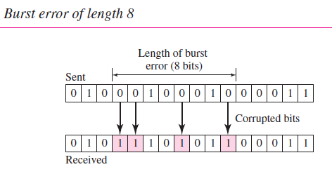

Slide 9
Error detection
Error detection means to decide whether the received data is correct or not without having a copy of the original message.
Error detection uses the concept of redundancy, which means adding extra bits for detecting errors at the destination.
Notes:
Make sense of message.
Make sense of message.

Slide 10
Redundancy

Slide 11
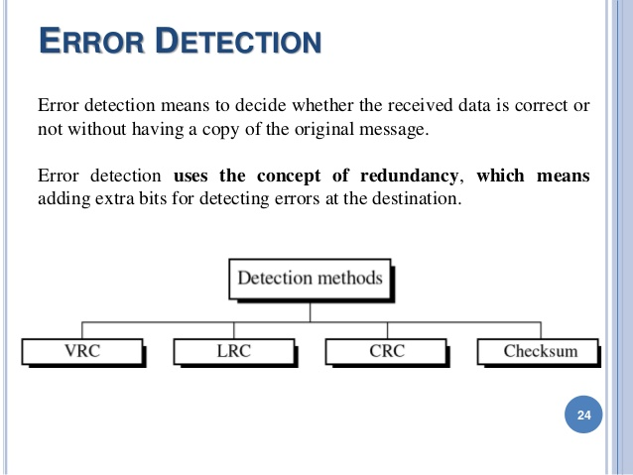
Four types of redundancy checks are used
in data communications

Slide 12
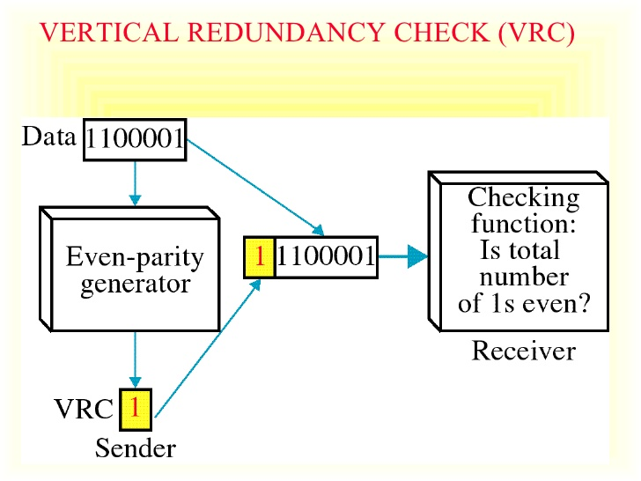
VRC or parity check is the simplest and most popular error detection scheme. In this technique, a redundant bit, called a parity bit, is appended to every data unit so that the total number of 1s in the unit becomes even.

Slide 13
VRC or parity check or single-parity check
It is the simple mechanism and inexpensive to detect the errors.
In this technique, a redundant bit is also known as a parity bit which is appended at the end of the data unit so that the number of 1s becomes even.
If the number of 1s bits is odd, then parity bit 1 is appended and if the number of 1s bits is even, then parity bit 0 is appended at the end of the data unit.
At the receiving end, the parity bit is calculated from the received data bits and compared with the received parity bit.
This technique generates the total number of 1s even, so it is known as even-parity checking.

Slide 14
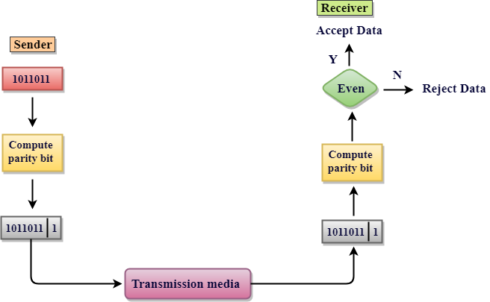
Vertical Redundancy Check
VRC

Slide 15
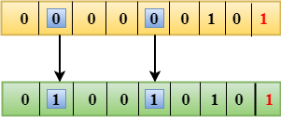
Performance Of VRC
It can only detect single-bit errors which are very rare.
If two bits are interchanged, then it cannot detect the errors.

Slide 16
Longitudinal Redundancy Check (LRC)
Organize data into a table and create a parity for each column
11100111 11011101 00111001 10101001
11100111
11011101
00111001
10101001
10101010
11100111 11011101 00111001 10101001 10101010
Original Data
LRC

Slide 17
Performance
LCR increases the likelihood of detecting burst errors.
If two bits in one data units are damaged and two bits in exactly the same positions in another data unit are also damaged, the LRC checker will not detect an error.

Slide 18
VRC and LRC (Two-Dimensional Parity Check )
Organizes the data in the form of a table.
Parity check bits are computed for each row, which is equivalent to the single-parity check.
In Two-Dimensional Parity check, a block of bits is divided into rows, and the redundant row of bits is added to the whole block.
At the receiving end, the parity bits are compared with the parity bits computed from the received data.

Slide 19
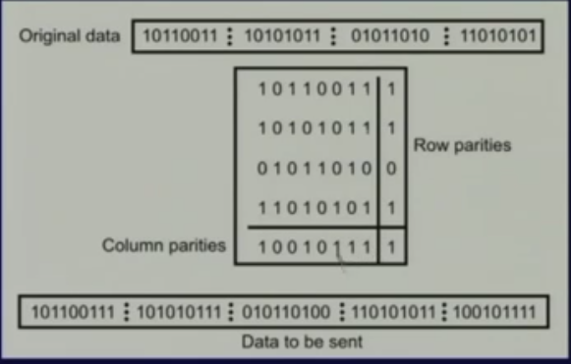
VRC and LRC

Slide 20
Drawbacks Of VRC and LRC
If two bits in one data unit are corrupted and two bits exactly the same position in another data unit are also corrupted, then 2D Parity checker will not be able to detect the error.
This technique cannot be used to detect the 4-bit errors or more in some cases.

Slide 21
Cyclic Redundancy Check
Given a k-bit frame or message, the transmitter generates an n-bit sequence, known as a frame check sequence (FCS), so that the resulting frame, consisting of (k+n) bits, is exactly divisible by some predetermined number.
The receiver then divides the incoming frame by the same number and, if there is no remainder, assumes that there was no error.

Slide 22
Find the CRC for the data block 100100 with the divisor 1101.
Steps:
Find the length of divisor (D).
Append D-1 bits to the original message.
Perform binary division.
Remainder of division= CRC

Slide 23
Binary Division

Slide 24
Polynomial and Divisor

Slide 25
Checksum

Slide 26
At the sender
Checksum
The unit is divided into k sections, each of n bits.
All sections are added together using one’s complement to get the sum.
The sum is complemented and becomes the checksum.
The checksum is sent with the data

Slide 27
At the receiver
Checksum
The unit is divided into k sections, each of n bits.
All sections are added together using one’s complement to get the sum.
The sum is complemented.
If the result is zero, the data are accepted: otherwise, they are rejected.

Slide 28
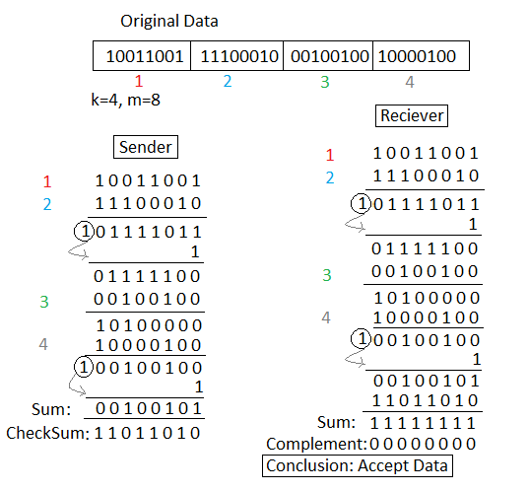

Slide 29
Performance
The checksum detects all errors involving an odd number of bits.
It detects most errors involving an even number of bits.
If one or more bits of a segment are damaged and the corresponding bit or bits of opposite value in a second segment are also damaged, the sums of those columns will not change and the receiver will not detect a problem.

Slide 30
Error Correction
It can be handled in two ways:
receiver can have the sender retransmit the entire data unit.
The receiver can use an error-correcting code, which automatically corrects certain errors.

Slide 31
Single-bit error correction/ Hamming code
To correct an error, the receiver reverses the value of the altered bit. To do so, it must know which bit is in error.
Number of redundancy bits needed
Let data bits = m
Redundancy bits = r
∴Total message sent = m+r
The value of r must satisfy the following relation:
2^{r} ≥ m+r+1

Slide 32
Table: Data and redundancy bits
Number of data bits m | Number of redundancy bits r | Total bits m + r
1 | 2 | 3
2 | 3 | 5
3 | 3 | 6
4 | 3 | 7
5 | 4 | 9
6 | 4 | 10
7 | 4 | 11

Slide 33
Error Correction

Slide 34
Hamming Code

Slide 35
Hamming Code

Slide 36
Hamming Code

Slide 37
Example of Hamming Code

Slide 38
Single-bit error

Slide 39
Error
Detection

Slide 40
Hamming Distance
The Hamming distance between two words (of the same size) is the number of differences between the corresponding bits. We show the Hamming distance between two words x and y as d(x, y).
The Hamming distance can easily be found if we apply the XOR operation (⊕) on the two words and count the number of 1s in the result. Note that the Hamming distance is a value greater than zero.
Example 10.4
Let us find the Hamming distance between two pairs of words.
1. The Hamming distance d(000, 011) is 2 because 000 ⊕ 011 is 011 (two 1s).
2. The Hamming distance d(10101, 11110) is 3 because 10101 ⊕ 11110 is 01011 (three 1s).

Slide 41
FLOW AND ERROR CONTROL
Flow control refers to a set of procedures used to restrict the amount of data that the sender can send before waiting for acknowledgment.
Any receiving device has a limited speed at which it can process incoming data and a limited amount of memory in which to store incoming data.
The receiving device must be able to inform the sending device before those limits are reached and to request that the transmitting device send fewer frames or stop temporarily.

Slide 42
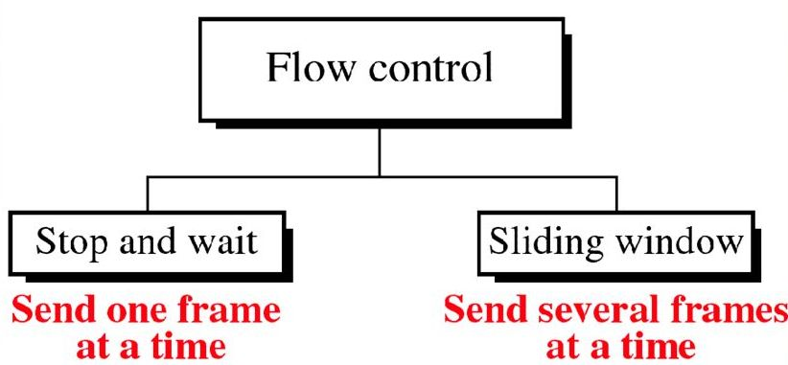

Slide 43
ERROR CONTROL
Error control in the data link layer is based on automatic repeat request, which is the retransmission of data.
Error control is both error detection and error correction. It allows the receiver to inform the sender of any frames lost or damaged in transmission and coordinates the retransmission of those frames by the sender.

Slide 44
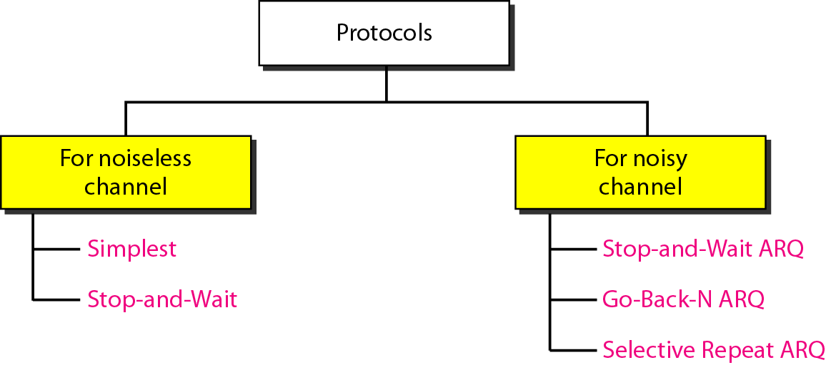
FLOW AND ERROR CONTROL

Slide 45
NOISELESS CHANNELS
No frames are lost, duplicated, or corrupted
The data link layer at the sender site gets data from its network layer, makes a frame out of the data, and sends it.
The data link layer at the receiver site receives a frame from its physical layer, extracts data from the frame, and delivers the data to its network layer.
The data link layers use the services provided by their physical layers for the physical transmission of bits.

Slide 46
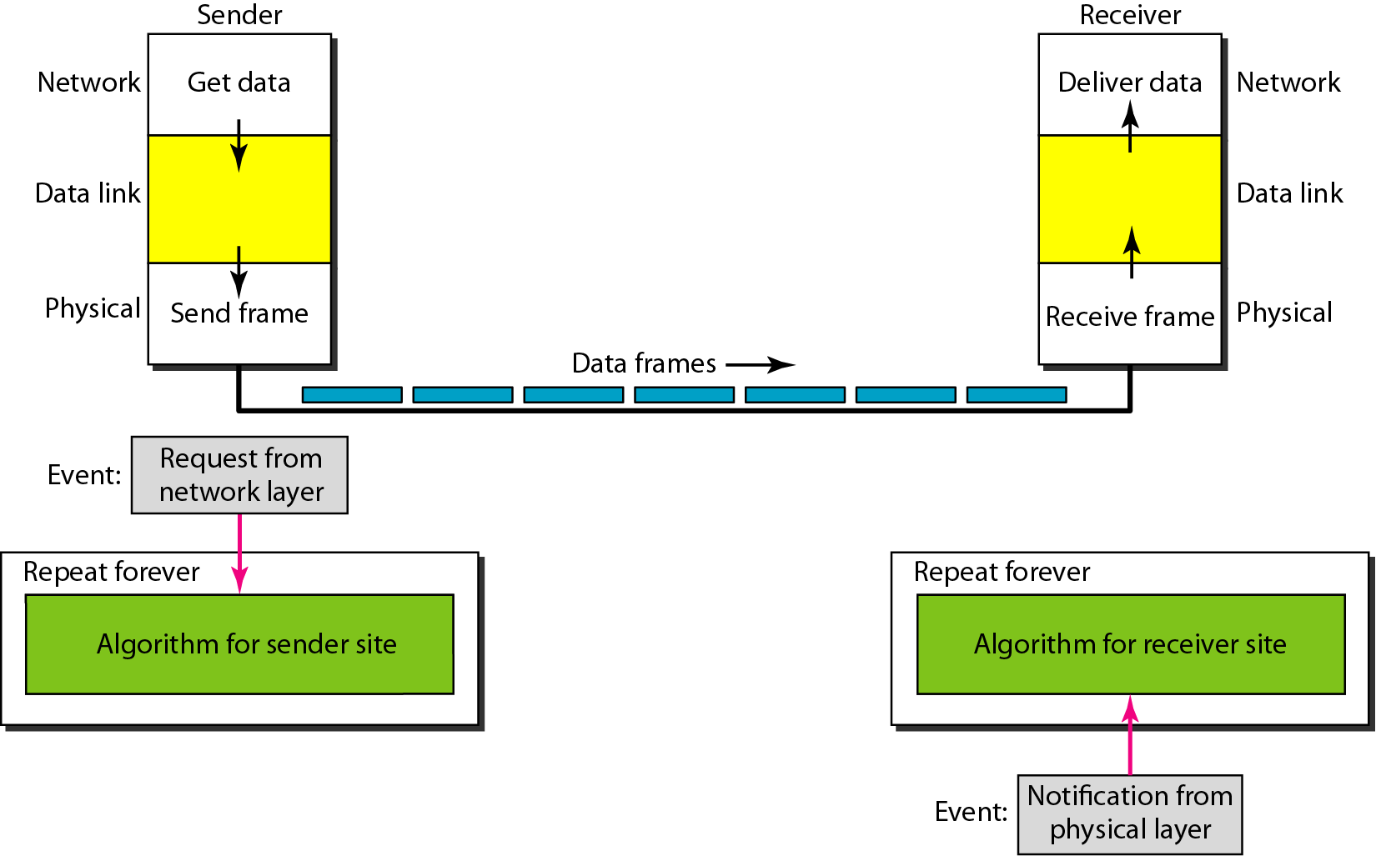
The design of the simplest protocol with no flow or error control-

Slide 47
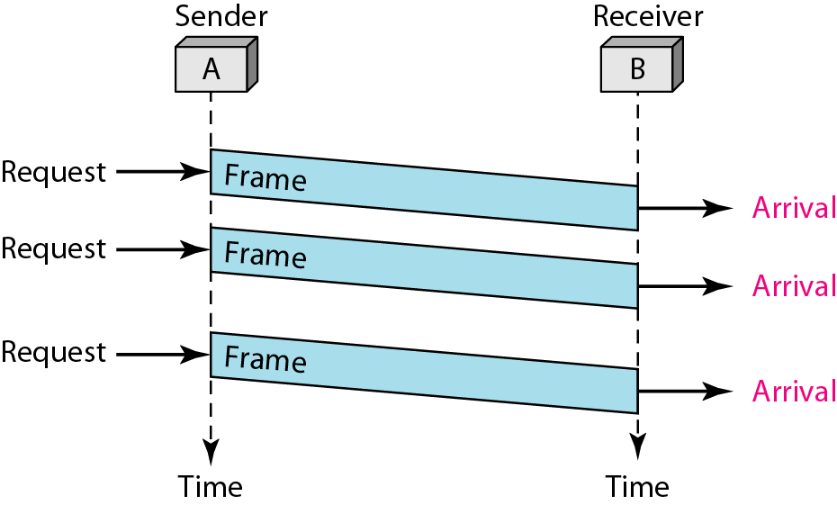
SIMPLEST PROTOCOL

Slide 48
Simplest protocol- Drawback
The sender sends a sequence of frames without even thinking about the receiver.
To send three frames, three events occur at the sender site and three events at the receiver site.

Slide 49
Stop-and-Wait Protocol
•It is still very simple. The primitives of stop and wait protocol are:
Sender side
Rule 1: Sender sends one data packet at a time.
Rule 2: Sender sends the next packet only when it receives the acknowledgment of the previous packet.
Therefore, the idea of stop and wait protocol in the sender's side is very simple, i.e., send one packet at a time, and do not send another packet before receiving the acknowledgment.

Slide 50
Stop-and-Wait Protocol
Receiver side
Rule 1: Receive and then consume the data packet.
Rule 2: When the data packet is consumed, receiver sends the acknowledgment to the sender.
Therefore, the idea of stop and wait protocol in the receiver's side is also very simple, i.e., consume the packet, and once the packet is consumed, the acknowledgment is sent. This is known as a flow control mechanism.

Slide 51
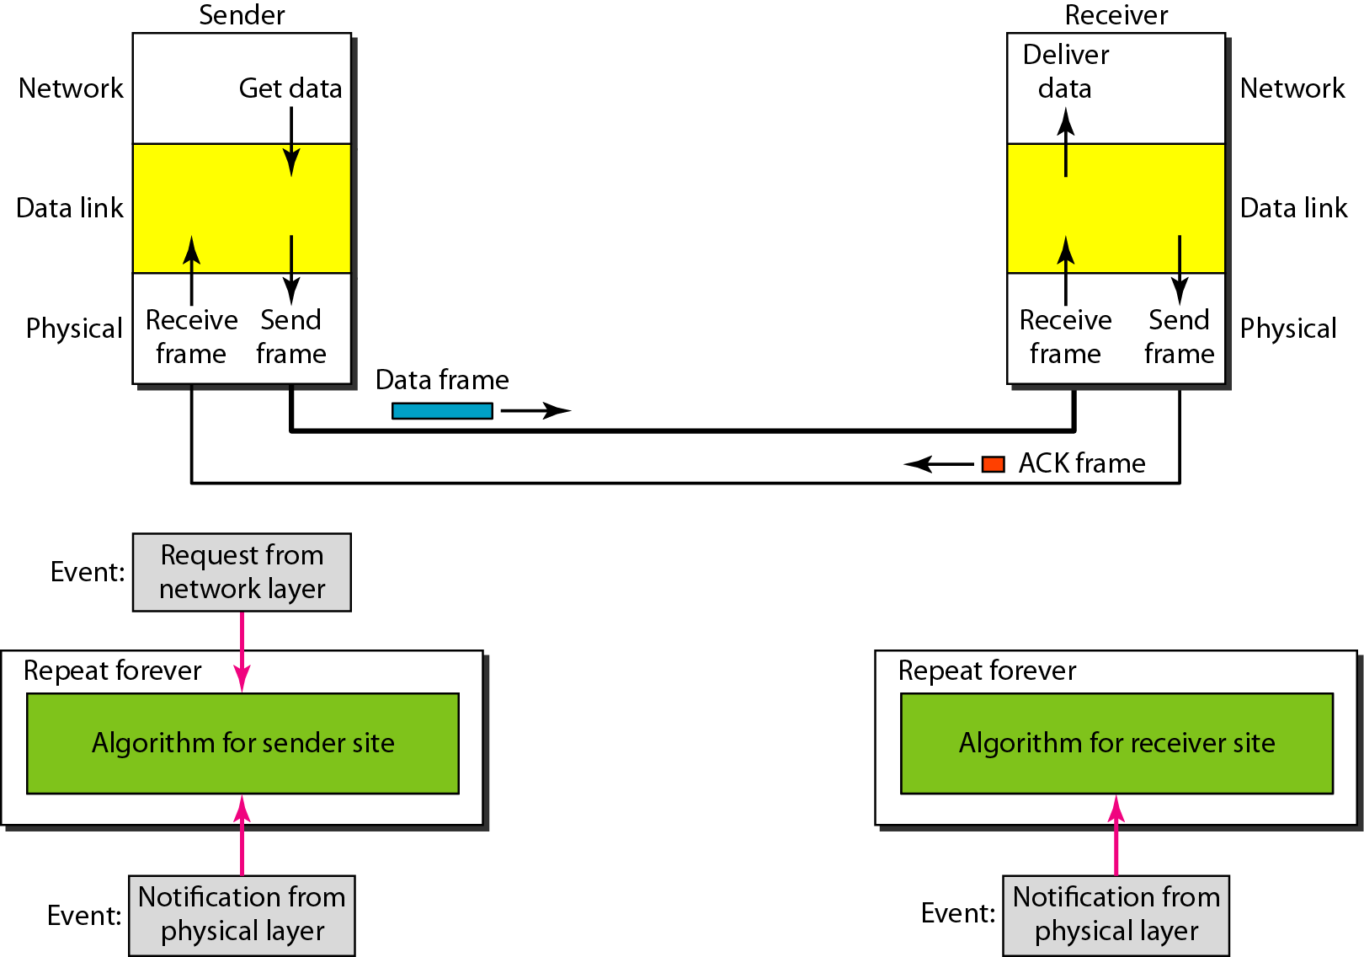
The design of Stop-and-Wait Protocol

Slide 52
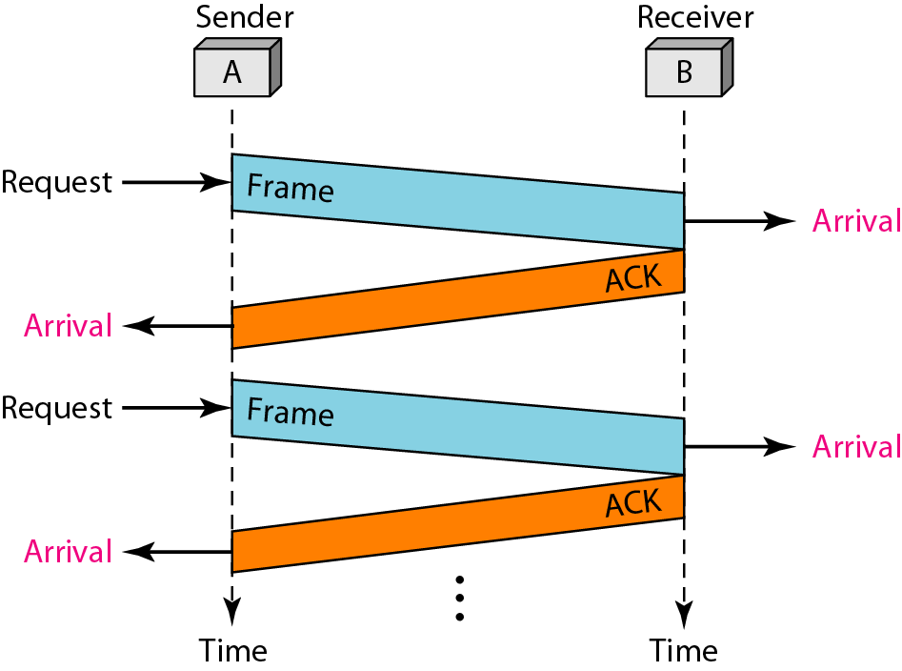
Stop-and-Wait Protocol

Slide 53
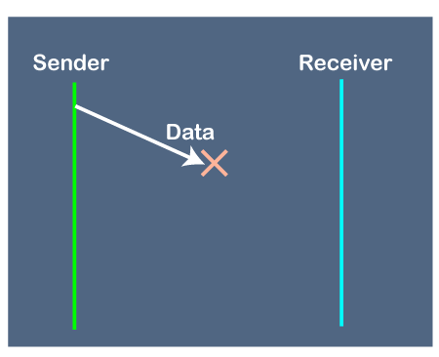
Disadvantages of Stop and Wait protocol
1. Problems occur due to lost data
Suppose the sender sends the data and the data is lost. The receiver is waiting for the data for a long time. Since the data is not received by the receiver, so it does not send any acknowledgment.

Slide 54
Since the sender does not receive any acknowledgment so it will not send the next packet. This problem occurs due to the lost data.
In this case, two problems occur:
Sender waits for an infinite amount of time for an acknowledgment.
Receiver waits for an infinite amount of time for a data.

Slide 55
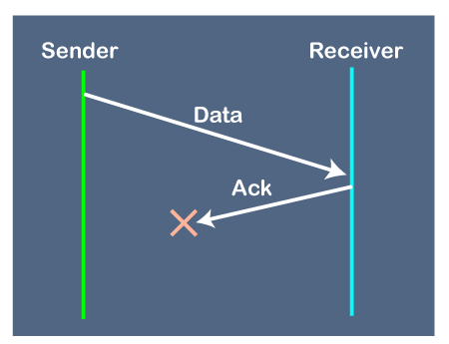
2. Problems occur due to lost acknowledgment
Suppose the sender sends the data and it has also been received by the receiver. On receiving the packet, the receiver sends the acknowledgment. In this case, the acknowledgment is lost in a network, then is no chance for the sender to receive the acknowledgment.

Slide 56
There is also no chance for the sender to send the next packet as in stop and wait protocol, the next packet cannot be sent until the acknowledgment of the previous packet is received.
In this case, one problem occurs:
Sender waits for an infinite amount of time for an acknowledgment.

Slide 57
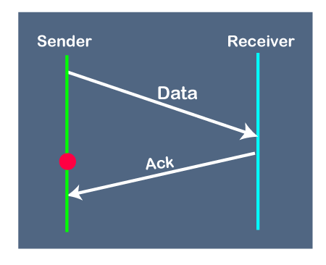
Problem due to the delayed data or acknowledgment
Suppose the sender sends the data and it has also been received by the receiver. The receiver then sends the acknowledgment. But the acknowledgment is received after the timeout period on the sender's side. As the acknowledgment is received late,
so acknowledgment can be wrongly considered as the acknowledgment of some other data packet.

Slide 58
Since the sender does not receive any acknowledgment so it will not send the next packet. This problem occurs due to the lost data.
In this case, two problems occur:
Sender waits for an infinite amount of time for an acknowledgment.
Receiver waits for an infinite amount of time for a data.

Slide 59
NOISY CHANNEL
Stop-and-Wait Automatic Repeat Request
Error correction in Stop-and-Wait ARQ is done by keeping a copy of the sent frame and retransmitting of the frame when the timer expires.
Since an ACK frame can also be corrupted and lost, it too needs redundancy bits and a sequence number. The ACK frame for this protocol has a sequence number field.
In this protocol, the sender simply discards a corrupted ACK frame or ignores an out-of-order one.

Slide 60
Sequence no &ACK in Stop-and-Wait Automatic Repeat Request
In Stop-and-Wait ARQ, numbering frames prevents the retaining of duplicate frames.
Numbered acknowledgments are needed if an acknowledgment is delayed and the next frame is lost.
Stop and Wait ARQ
=
Stop and Wait Protocol + Time Out Timer + Sequence Numbers for Data Packets and Acknowledgements

Slide 61
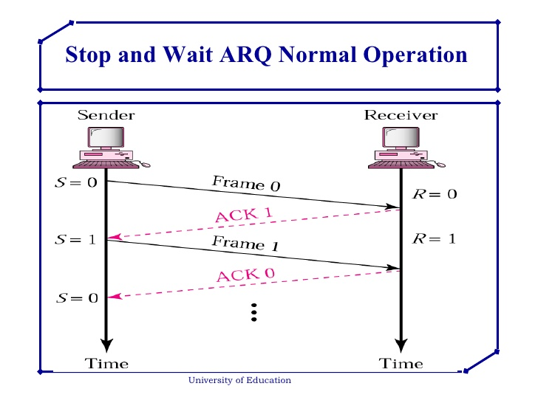

Slide 62
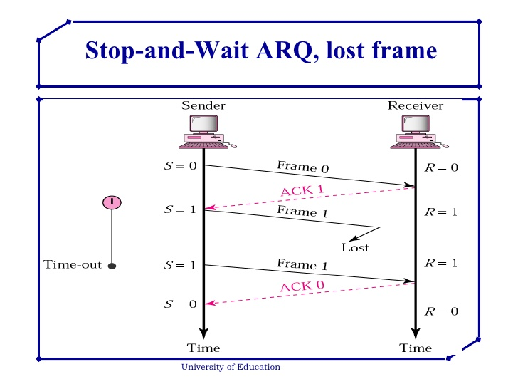

Slide 63
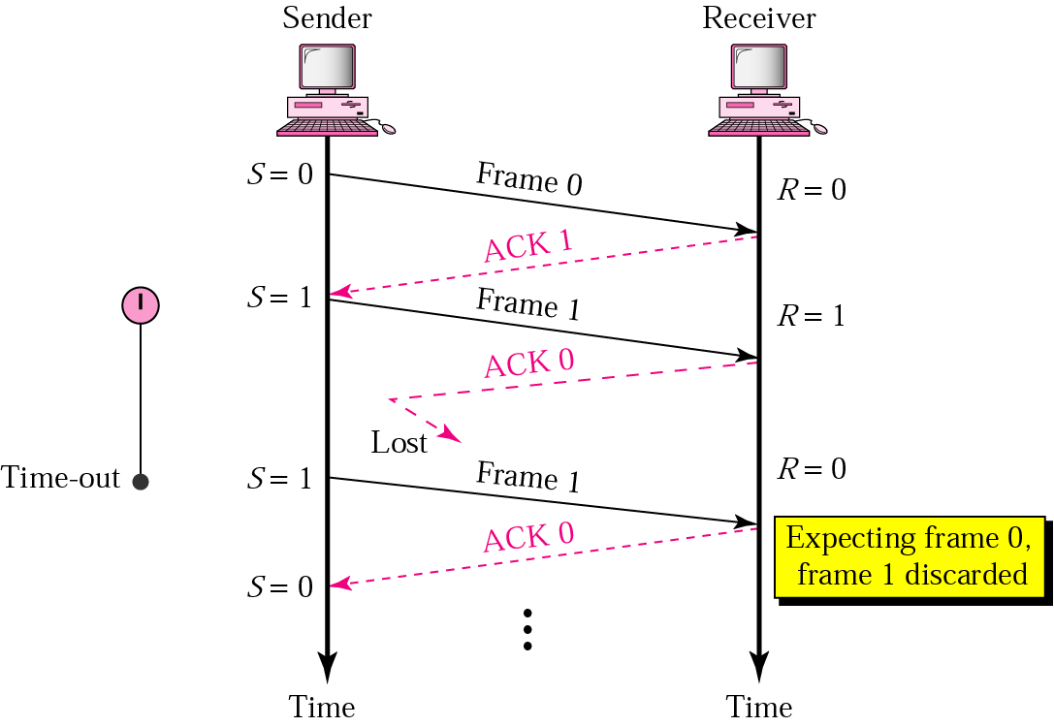
Stop-and-Wait ARQ, lost ACK frame

Slide 64
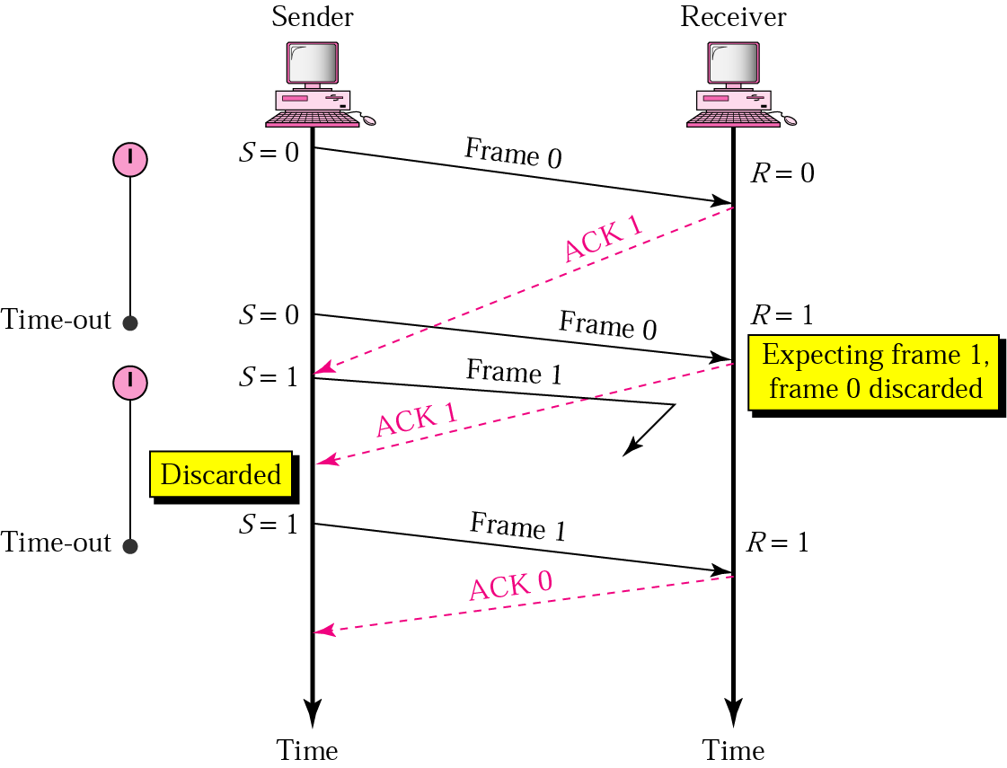
Stop-and-Wait ARQ, delayed ACK

Slide 65
Sliding Window Protocol
The sliding window is a technique for sending multiple frames at a time. It is also used in TCP Protocol.
In this technique, each frame has sent from the sequence number. The sequence numbers are used to find the missing data in the receiver end.
The purpose of the sliding window technique is to avoid duplicate data, so it uses the sequence number.
Types of Sliding Window Protocol
Sliding window protocol has two types:
Go-Back-N ARQ
Selective Repeat ARQ

Slide 66
Go-Back-N Automatic Repeat Request
In this protocol we can send several frames before receiving acknowledgments; we keep a copy of these frames until the acknowledgments arrive.
The sender window can slide one or more slots when a valid acknowledgment arrives.
The window slides when a correct frame has arrived; sliding occurs one slot at a time.

Slide 67
Go-Back-N ARQ
Sequence Number (0 to 2^{m}-1)
Sender and Receiver Sliding Window
(sender window size is=2^{m}-1)
(Receiver window size=1)
Acknowledgment
Resending Frames

Slide 68
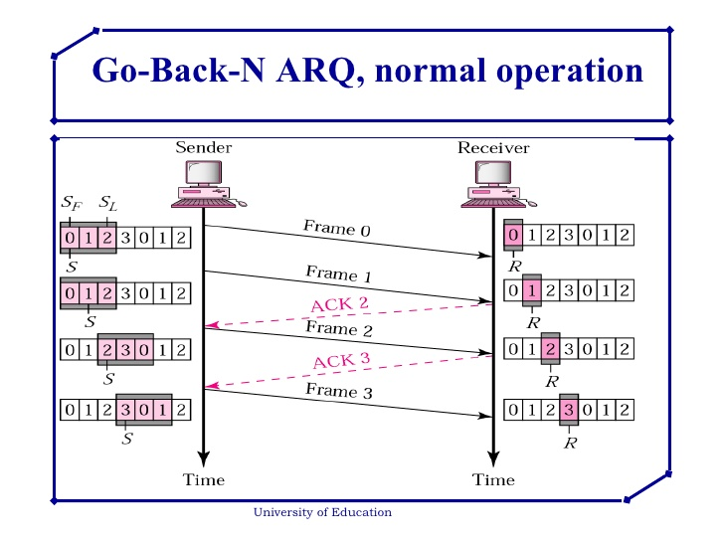
FLOW AND ERROR CONTROL

Slide 69
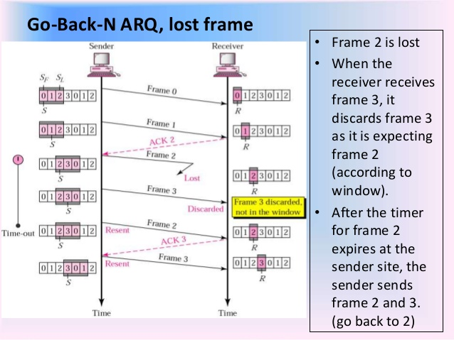

Slide 70
Note:
In Go-Back-N ARQ, the size of the sender window must be less than 2^{m}; the size of the receiver window is always 1.

Slide 71
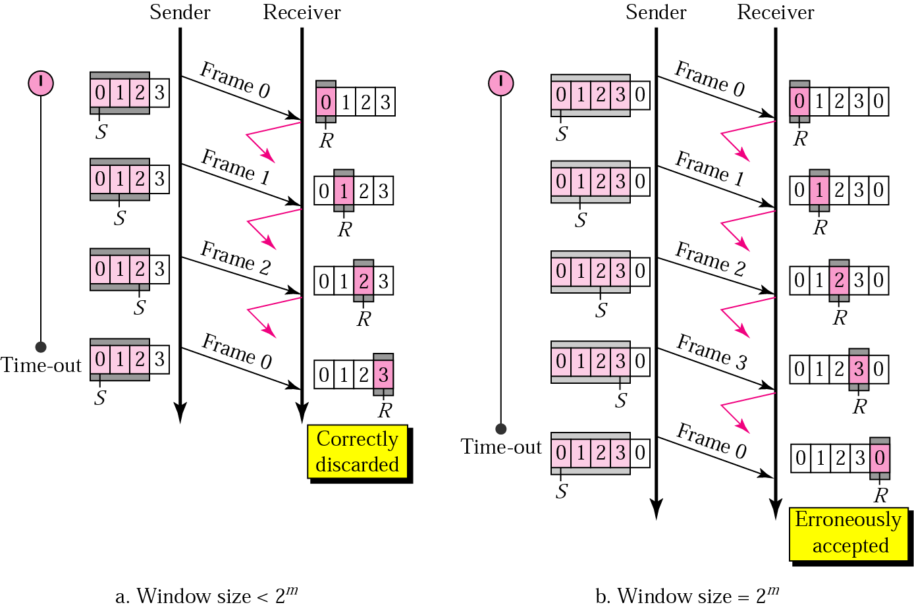
Go-Back-N ARQ: sender window size

Slide 72
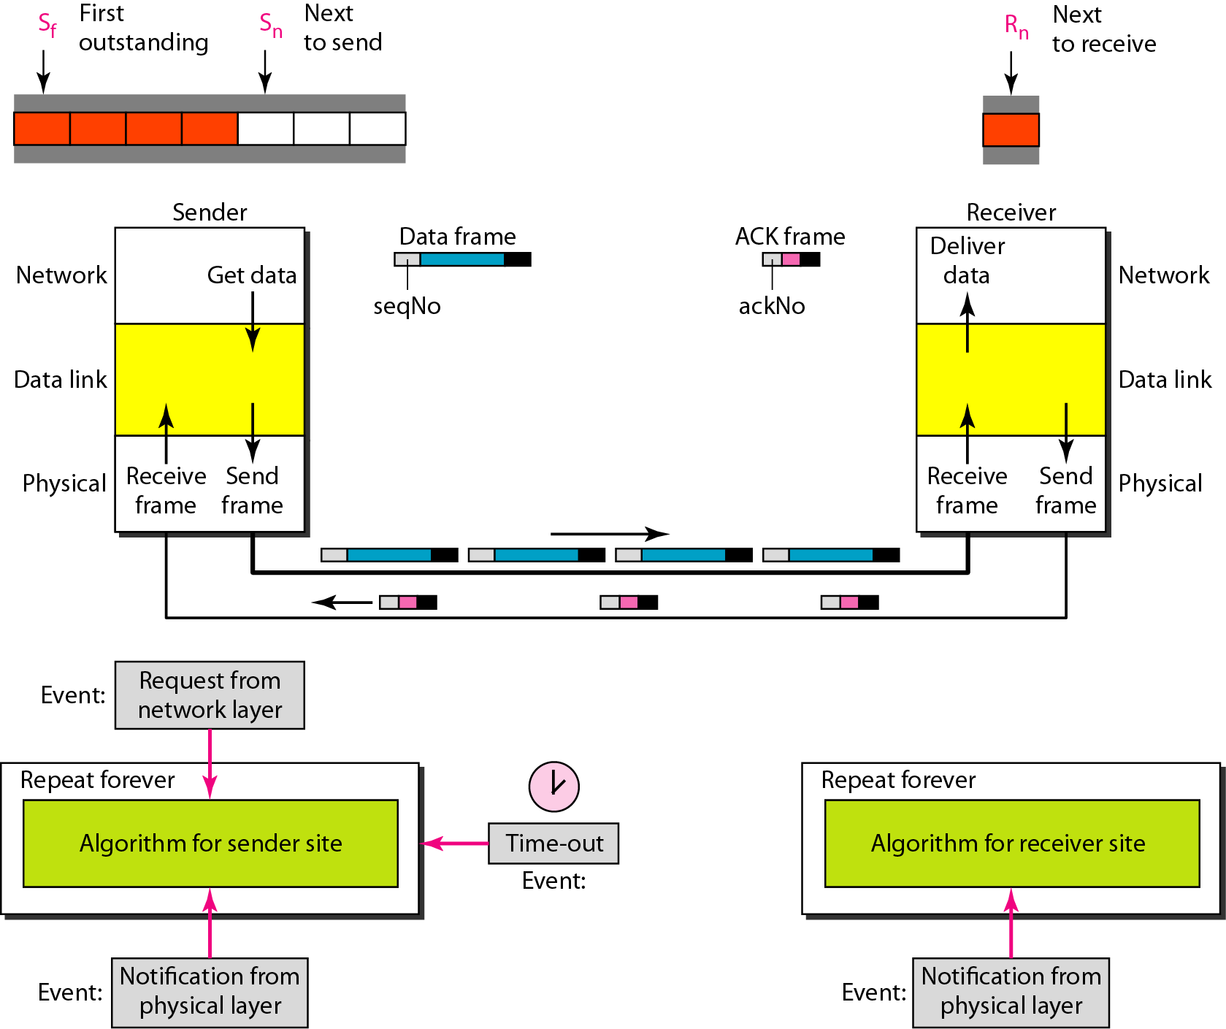
Design of Go-Back-N ARQ

Slide 73
Selective-Repeat ARQ
Sender and Receiver Windows
In SR protocol, sender window size is always same as receiver window size.
In Selective Repeat ARQ, the size of the sender and receiver window must be 2^m-1 and seqeunce number= 2^m.
The receiver while keeping track of sequence numbers buffers the frames in memory and sends NACK for only frames which are missing or damaged. The sender will send/retransmit a packet for which NACK is received.

Slide 74
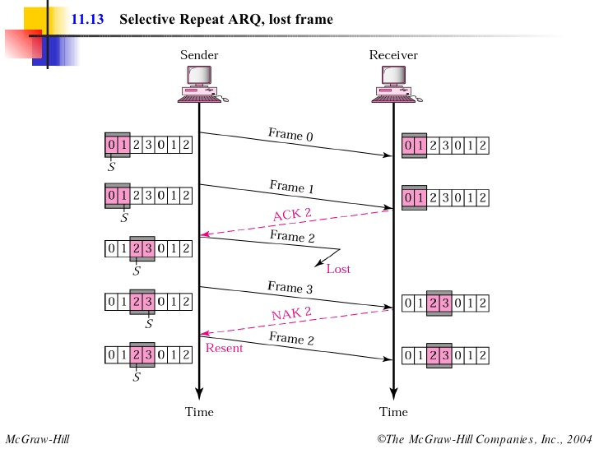

Slide 75
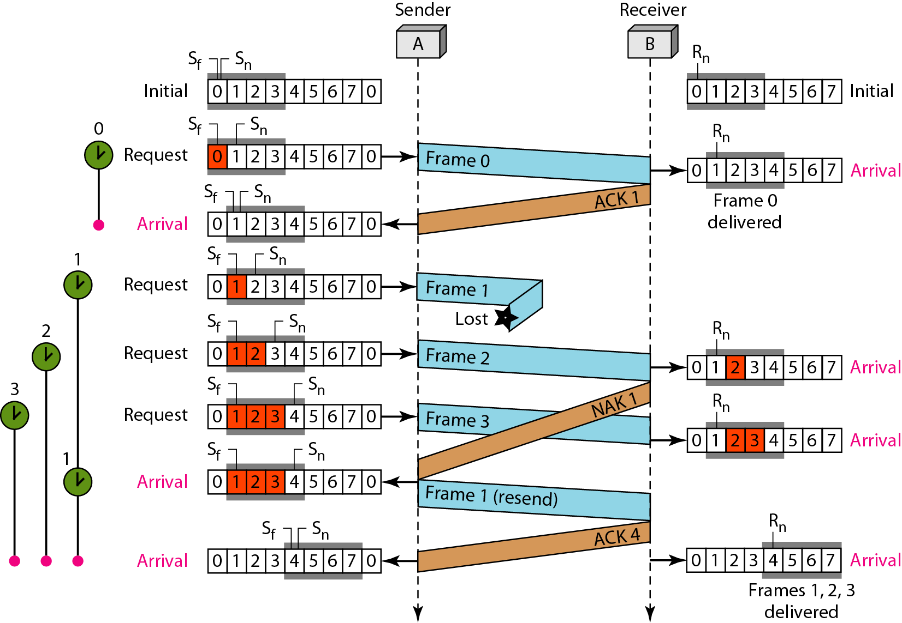
Flow diagram Selective Repeat Automatic Repeat Request

Slide 76
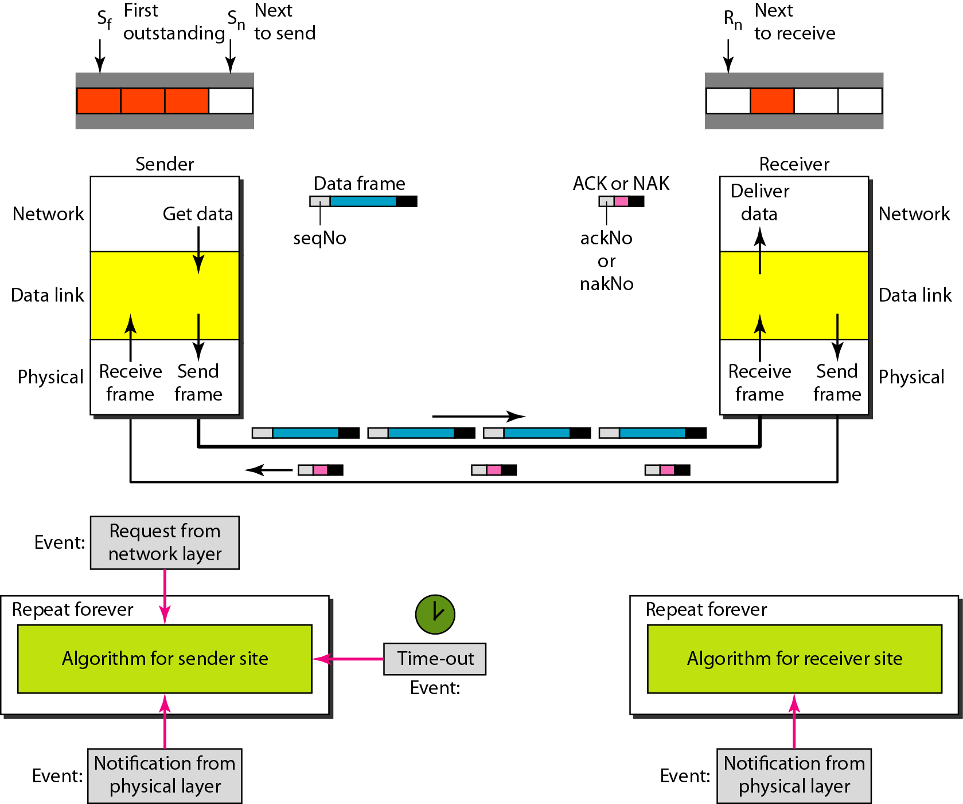
Design of Selective Repeat ARQ

Slide 77
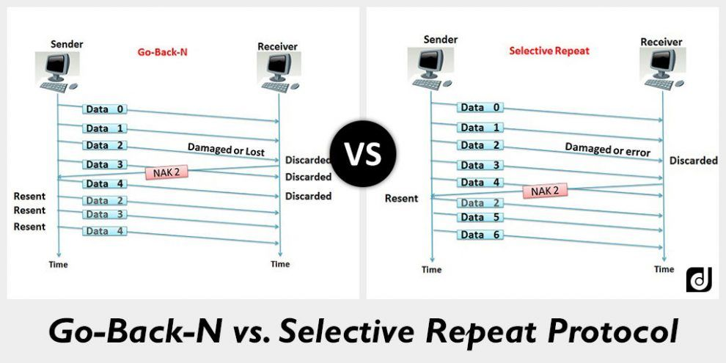

Slide 78
Numerical
Host A wants to send 10 frames to Host B. The Host agreed to go with Go-Back-4. How many number of frames are transmitted by Host A if every 6th frame that is transmitted by Host A is either corrupted or lost.

Slide 79
Piggybacking
In all practical situations, the transmission of data needs to be bi-directional. This is called as full-duplex transmission.
We can achieve this full duplex transmission i.e. by having two separate channels-one for forward data transfer and the other for separate transfer i.e. for acknowledgements.
A better solution would be to use each channel (forward & reverse) to transmit frames both ways, with both channels having the same capacity. If A and B are two users. Then the data frames from A to B are intermixed with the acknowledgements from A to B.

Slide 80
One more improvement that can be made is piggybacking. The concept is explained as follows:
In two way communication, Whenever a data frame is received, the received waits and does not send the control frame (acknowledgement) back to the sender immediately.
The receiver waits until its network layer passes in the next data packet. The delayed acknowledgement is then attached to this outgoing data frame.
This technique of temporarily delaying the acknowledgement so that it can be hooked with next outgoing data frame is known as piggybacking.

Slide 81
The major advantage of piggybacking is better use of available channel bandwidth.
The disadvantages of piggybacking are: 1. Additional complexity.
2. If the data link layer waits too long before transmitting the acknowledgement, then retransmission of frame would take place.

